Slide 1


Slide 2
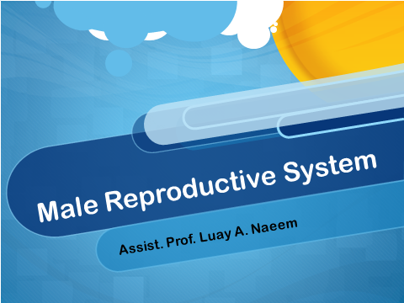

Slide 3

The male reproductive system

Slide 4
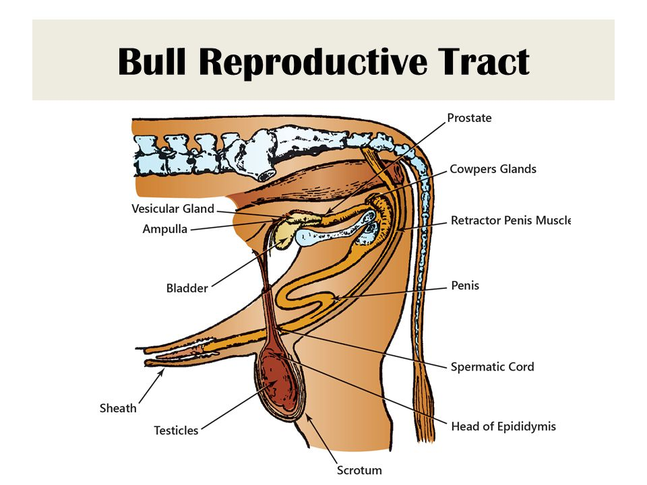

Slide 5
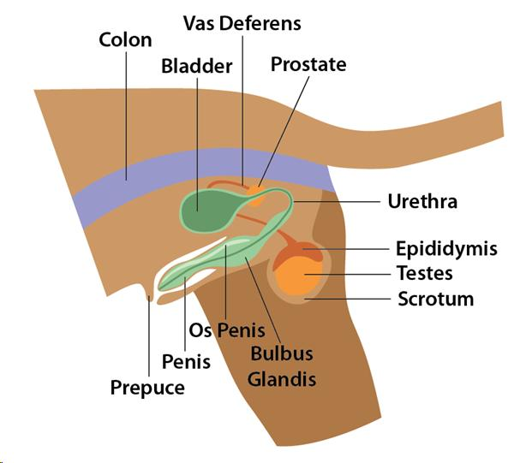

The male reproductive system (dog)
Consists of:-
1- Testes and Scrotum
2- Epididymis and vas deferens.
3- Vesicular, Prostate and Cowper's gland.
4- Urethra.
5- os penis.
6- Penis and Prepuce

Slide 6
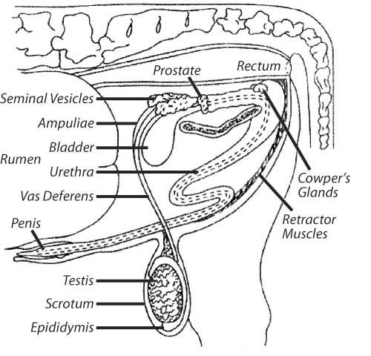
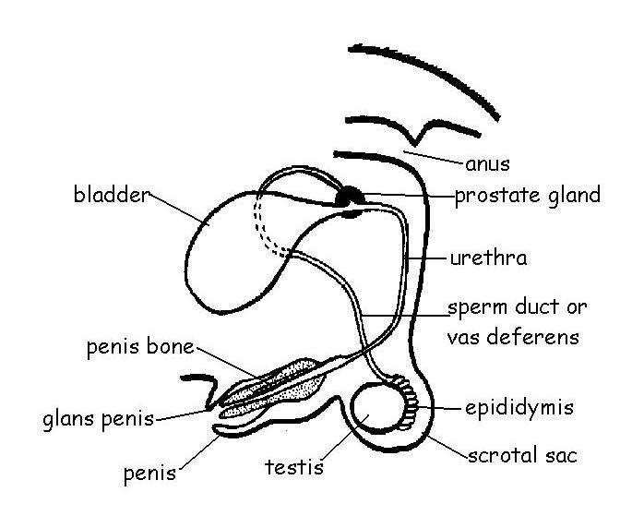
2
1

Slide 7

The primary functions of MRS

Slide 8
The primary functions of MRS
The organs of the male reproductive system are specialized for four primary functions To
1- Produce,
2- Maintain,
3- Transport, and
4- Nourish sperm (the male reproductive cells) and protective fluid ( semen ).

Slide 9
Teaser Bull
Part 1
A teaser bull is a term describing a bull whose reproductive system has been surgically altered to render him sterile. The purpose of bulls is to aid in detection of cows in estrus to facilitate when to artificially inseminate.
Tail head paint, mount detectors, and visual observation, all these methods depend on female cattle. Thus these methods might miss females with weak or short estrus behavior.

Slide 10

Choosing A Teaser Bull

Slide 11
Choosing A Teaser Bull
Several factors need to be considered when choosing a teaser bull:
Teaser bulls aged 1–3 years old age.
The ideal bull needs to be moderately sized, less than 272kg.
Mild temperament.
Easily handled.
Free of transmissible diseases.
The bull also needs strong libido.

Slide 12

Surgical Procedures

Slide 13
Surgical Procedures
Vasectomy
Epididymectomy
Penile–prepuce translocation

Slide 14
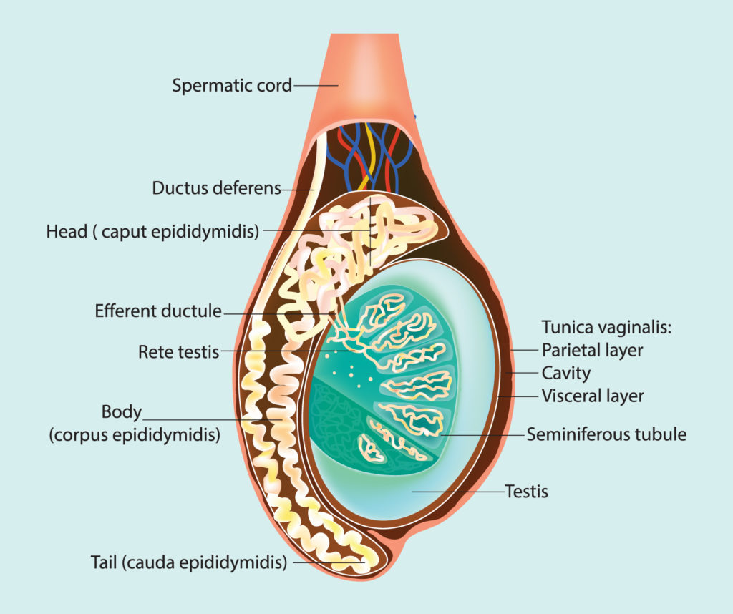

Slide 15

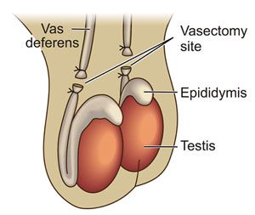
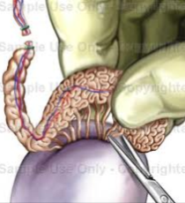
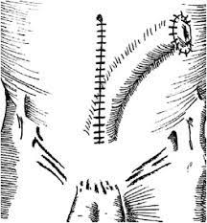
1
2
3

Slide 16
Vasectomy
Is a surgical procedure for male sterilization or permanent contraception, during the procedure, the male vas deferens are cut and tied or sealed so as to prevent sperm from entering into the urethra and thereby prevent fertilization of a female through sexual intercourse.

Slide 17
Surgical Procedure
1- The neck of the scrotum should be clipped and aseptically prepared for surgery.
2- Lidocaine 2% should be infused over the proposed incision site over each spermatic cord.
3- A 3-cm incision should be made through the skin and tunica dartos over each spermatic cord.

Slide 18
Cont.………………..
4- Then the spermatic cord is isolated by placing a hemostat underneath the entire spermatic cord.
5- The ductus deferens is then identified, the tunica vaginalis is carefully incised.
6- After the tunica vaginalis is incised, the ductus deferens is isolated and cutting.

Slide 19
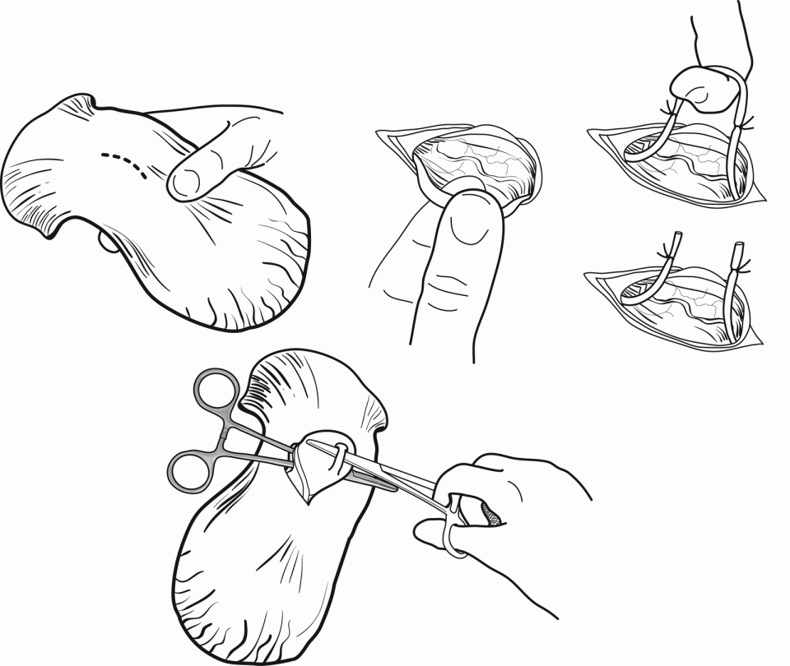
Procedure for vasectomy
1
3
4
2
5

Slide 20
Epididymectomy
1- the base of the scrotum is clipped and aseptically prepared.
2- Lidocaine 2% is infused over the tail of the epididymis.
3- the surgeon grasps the neck of the scrotum and pushes the testicle ventrally.
4- A 3-cm incision is made over the tail of the epididymis through the skin and common vaginal tunic until the epididymis is exteriorized.

Slide 21
Cont.……….
5- The tail of the epididymis is carefully dissected from the testicle and towel clamps or Allis tissue forceps can be used to assist in handling and manipulation of the epididymis.
6- Then a hemostat is placed on the ductus deferens and the body of the epididymis.
7- Two ligatures with (0) absorbable suture are placed proximal to the hemostats.
8- The tail of the epididymis is removed by transection distal to the hemostats.

Slide 22
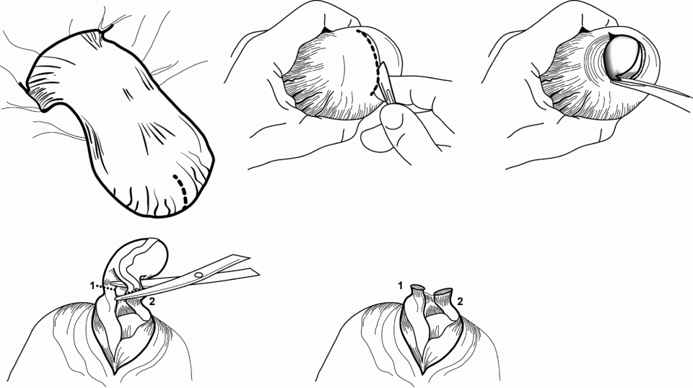
Procedure for Epididymectomy

Slide 23
Penile–prepuce Translocation
Penile–prepuce translocation (“sidewinder”) is the surgical transposition of the penis and prepuce from ventral midline to the right or left flank of a bull.
In general, “sidewinders” are preferred due to
1- longevity and herd retention of the teaser animal.
2- Bulls with a penile–prepuce translocation maintain better and longer libido
3- This procedure allows normal protrusion and does not cause pain during erection.

Slide 24
Cont..……
Disadvantage
Some bulls are able to compensate and learn how to breed females despite the translocation of the penis and prepuce.
Therefore it is recommended that a vasectomy or epididymectomy is performed to ensure sterility of the bull.

Slide 25
Surgical Procedure
1- Penile–prepuce translocation is performed in lateral recumbency, so general anesthesia or heavy sedation with rope restraints and local infiltration of 2% lidocaine can be used.
2- Ideally, food should be withheld for 24 hours and water for 12 hours prior to performing the procedure.
3- Prior to placing the bull in recumbency, the translocation site for the preputial orifice should be identified.
4- The translocation site should be just outside the flank fold and lateral to the original preputial orifice site.

Slide 26
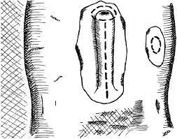
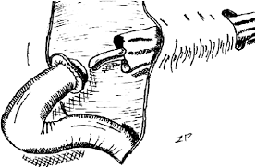
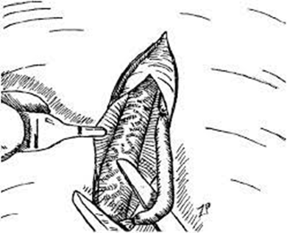

Penile–prepuce translocation
1
3
2
4

Slide 27
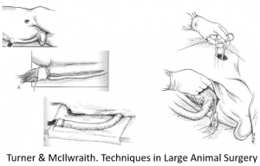

Slide 28
Video
https://youtu.be/Oy0yxkigriA

Slide 29
Part 2
Affections of penis and prepuce
Animals with diseases of the penis and prepuce can be presented for a variety of clinical signs.
Commonly, discharge or hemorrhage from the prepuce is the presenting complaint. Other clinical problems associated with penis and prepuce disorders are abnormal urination, neoplasia, inability to mate, or persistent penile erection and urethral disorders.

Slide 30

Male Reproductive Sys.

Slide 31
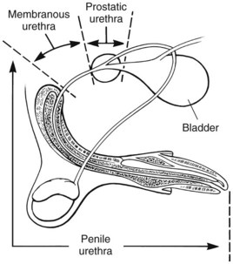
Male Reproductive Sys. Dog

Slide 32
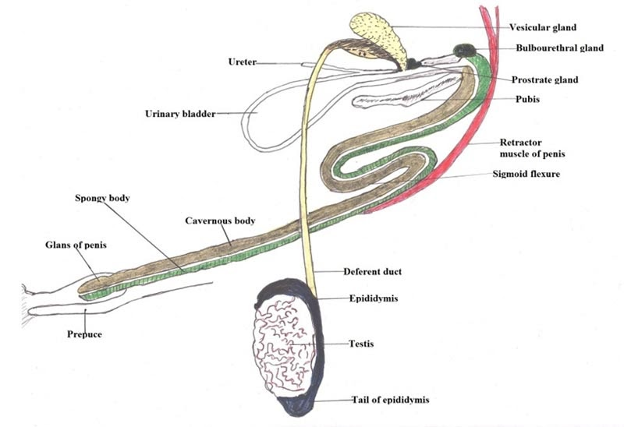
Male Reproductive Sys. Bull

Slide 33
ETIOLOGY
Congenital Disorders of the Penis and Prepuce:
1- Persistent Penile Frenulum
2- Hypospadias
3- Phimosis (congenital or acquired)
4- Os Penis Deformity

Slide 34
Persistent Penile Frenulum
• During the perinatal period, the surface of the glans penis and the preputial mucosa separate. When this separation fails, abnormal connective tissue, most commonly joining the ventral midline of the distal penis and prepuce, persists, resulting in the inability of the penis to extrude fully from the prepuce.

Slide 35
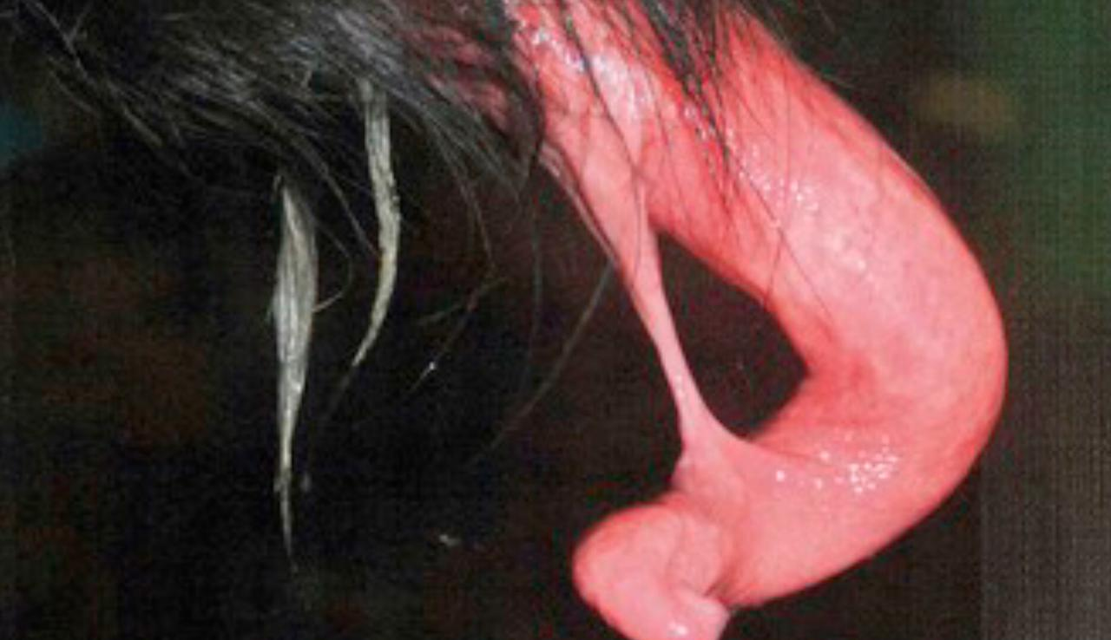
Persistent Penile Frenulum

Slide 36
Hypospadia
The condition is due to incomplete masculinization during development, and it can be associated with an underdeveloped penis and/or with preputial malformations.
Hypospadia results from abnormal closure of the urethral tube during development and can cause one or more abnormal urethral orifices located anywhere along the length of the urethra.
Most commonly, the abnormal orifice is located along the ventral aspect of the penis and prepuce, but it may extend through the scrotal region to the perineal region.

Slide 37
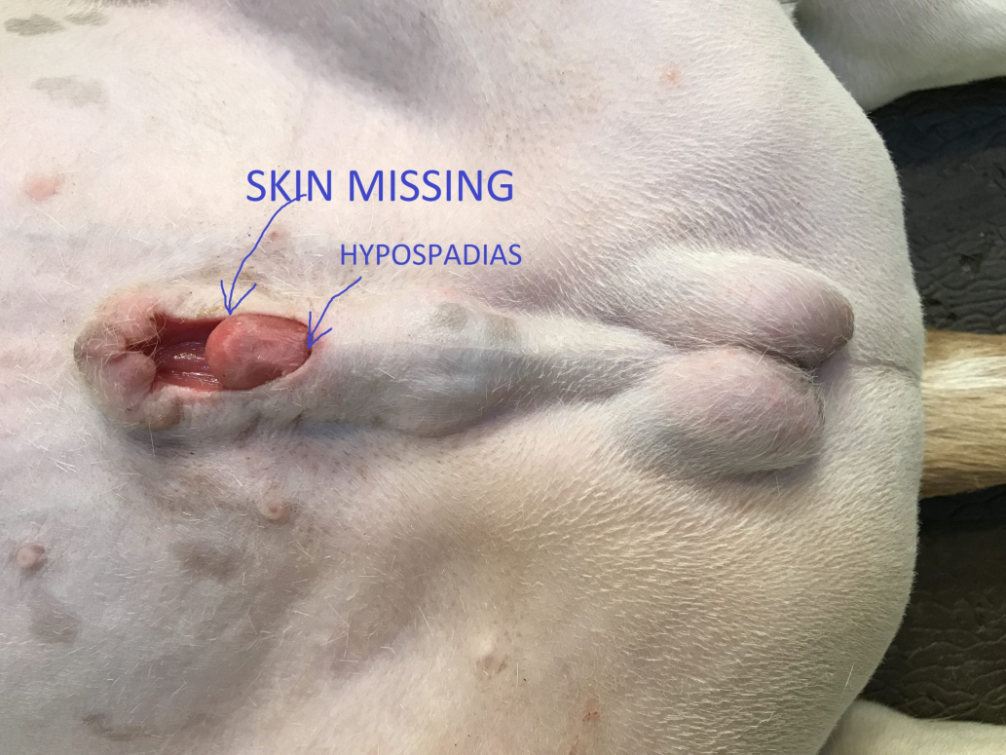
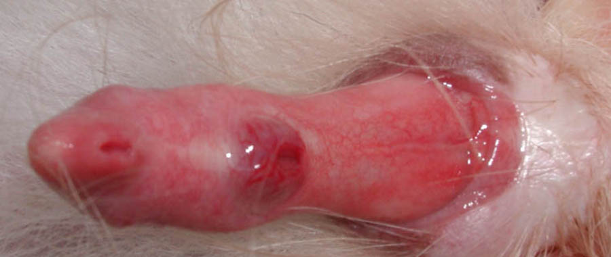
Hypospadias in dogs

Slide 38
Type of Hypospadias
Normal urethra meatus
Glandular
Penile
Scrotal
Perineal
Anal

Slide 39
Treatment
Urethrostomy and surgical excision of preputial and penile remnants, bilateral orchidectomy, and enlargement or maintenance of the urethral orifice in the scrotal or perineal region may be indicated in severe cases.

Slide 40
Urethrostomy
Types of Urethrostomy:
1- Penile Urethrostomy.
2- Scrotal Urethrostomy.
3- Perineal Urethrostomy.

Slide 42
Phimosis (congenital or acquired)
Phimosis is the inability to protrude the penis beyond the preputial orifice.
The clinical signs depend on the size of the preputial orifice and the underlying cause (congenital or acquired).

Slide 43
Cont.………
Congenital phimosis is usually accompanied by a distended prepuce and an inability to urinate normally. Urine can often be passed only in drops or a thin stream. Despite these signs, the puppy or kitten is rarely distressed.
Urinary outflow obstruction, Preputial retention of urine results in balanoposthitis, and the infected area may ulcerate.

Slide 44
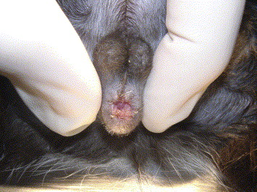
Congenital phimosis

Slide 45
Cont.……….
Acquired phimosis results from scarring after preputial trauma or neoplasia.
Preputial inflammation, edema, and associated licking of the area are common. A neoplasm or healing wound may also be present. Retention of urine within the prepuce can be seen in severe cases of acquired phimosis.

Slide 46
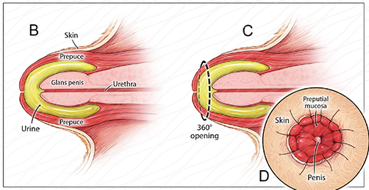
Phimosis

Slide 47
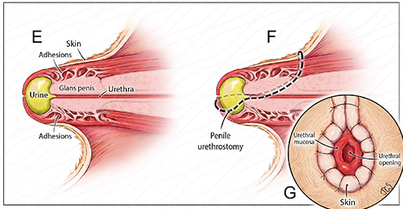
Phimosis With Adhesion

Slide 48
Os Penis Deformity
Deformity of the os penis may result in deviation of the penis and, depending on the severity, inability to retract the penis fully into the preputial sheath.
Mild deformities of the os penis (e.g., bends or excessive shortness) may result in misdirected copulatory efforts, inability to achieve vaginal penetration, and apparent infertility

Slide 49
Treatment
Treatment depends on the severity of the deformity and the intended use of the dog.
Severe deviations may require fracturing and straightening of the os penis.
An excessively shortened or deviated os penis that impairs the dog’s ability to copulate,
Therapy is probably not indicated if the dog is not intended for breeding and if paraphimosis or dysuria is not present.

Slide 50




Cont.…….
Acquired Penile and Preputial Disorders:
1- Priapism
2- Penile and Preputial wounds
3- Foreign Body
4- Neoplasia
5- Balanoposthitis

Slide 51
Priapism
Priapism is a persistent erection without sexual stimulation and is diagnosed by physical examination.
Partial paraphimosis can also result.
Priapism can be caused by myelopathy, drugs, vascular abnormalities, penile masses, trauma, or it can be idiopathic.
If necrosis or gangrene is severe, amputation of the penis and prepuce and urethrostomy might be necessary.

Slide 52
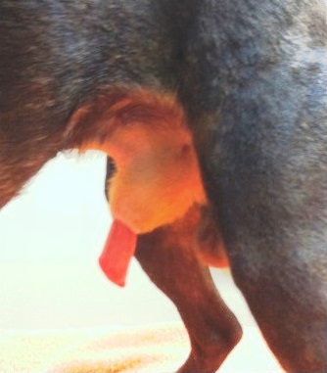
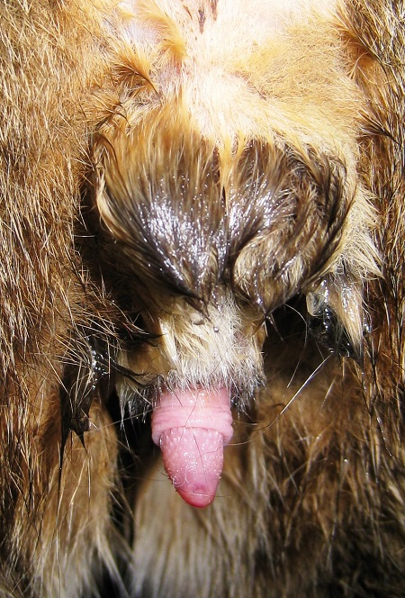
Priapism

Slide 53
Penile and Preputial wounds
May occur during mating, dog fights, and fence jumping or from automobile accidents or gunshot.
Penile lacerations and gunshot wounds may involve the urethra.
Severe penile trauma may produce a fracture of the os penis.
Wounds that penetrate into the preputial cavity or are near the preputial orifice are most likely to require surgical management.

Slide 54
Cont. ………
Management of superficial wounds often involves
avoiding self-inflicted trauma by preventing licking of the wound by the patient.
Initial cleansing of the wound followed by topical application of an antiseptic or antimicrobial agent may also be indicated.
Some wounds should be allowed to heal by second intention and other by first intention (surgical approach).

Slide 55
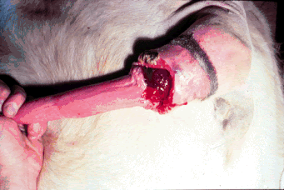
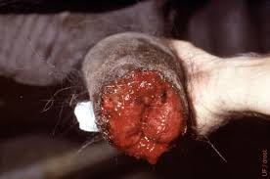

Slide 56
Penile and Preputial Foreign Body
Foreign bodies such as grass awns, plant seeds, pieces of straw, and urinary calculi can lodge in the preputial cavity.
The clinical signs are often mild and may be overlooked, A purulent, blood-tinged preputial discharge may be present, and the animal frequently licks the prepuce.
Migration of the foreign body through the preputial mucosa at the fornix results in swelling and abscess of tissues surrounding the penis.
The animal usually is painful, listless, and mildly pyretic and walks stiffly.

Slide 57
Neoplasia
Tumors involving the penis and prepuce include
Transmissible venereal tumor,
Papilloma,
Squamous cell carcinoma,
Mastocytoma, and
Osteosarcoma of the os penis

Slide 58
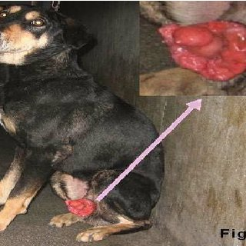

Slide 59
Balanoposthitis
Infections of the penis and prepuce are fairly common, constituting 20% of canine penile and preputial lesions

Slide 60
Cont.…..…..
Examination of the dog with balanoposthitis reveals
Inflamed, thickened penile and preputial mucosa.
Enlarged lymphoid nodules, particularly near the fornix of the preputial cavity.
Adhesions may develop between the prepuce and penis.
Severe cases. Balanoposthitis may be seen after penile injury accompanying phimosis, preputial foreign bodies, or neoplasia.

Slide 61
Prescrotal urethrotomy. The retractor penis muscle is retracted laterally, and the urethra is incised on midline just caudal to the os penis.

Slide 64
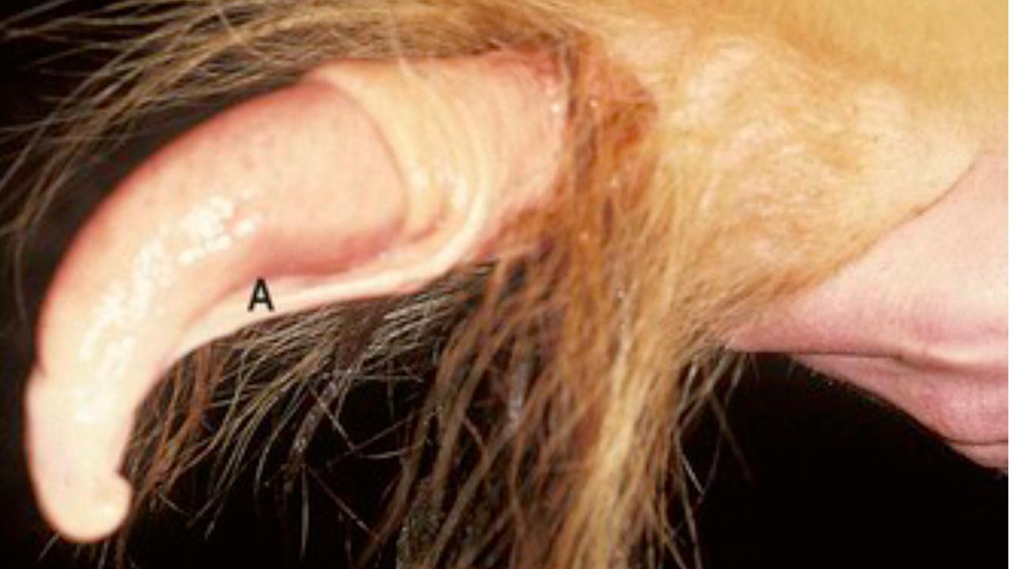
Congenital male abnormalities
Persistent penile preputial frenulum persistence of or incomplete separation of the penis and prepuce
Persistent preputial frenulum with penile deviation

Slide 65
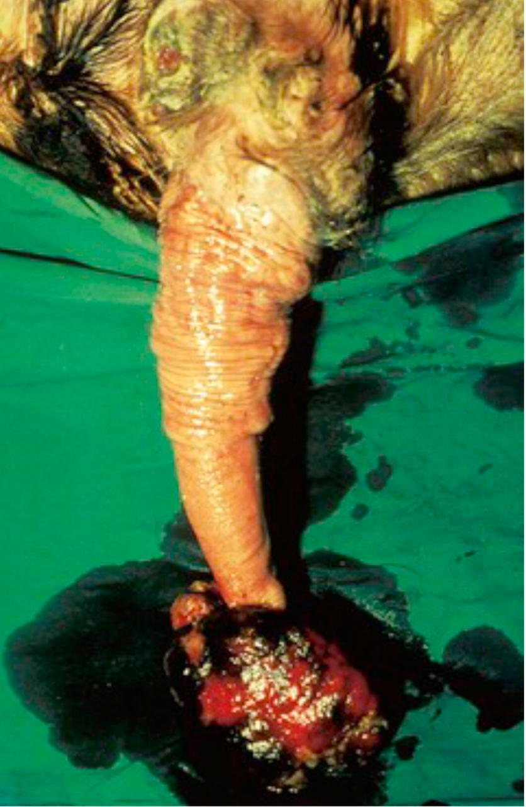
Penile conditions
Fibropapilloma (“wart”) a benign tumor of epithelial and connective tissue caused by a species-specific papovavirus.

Slide 66
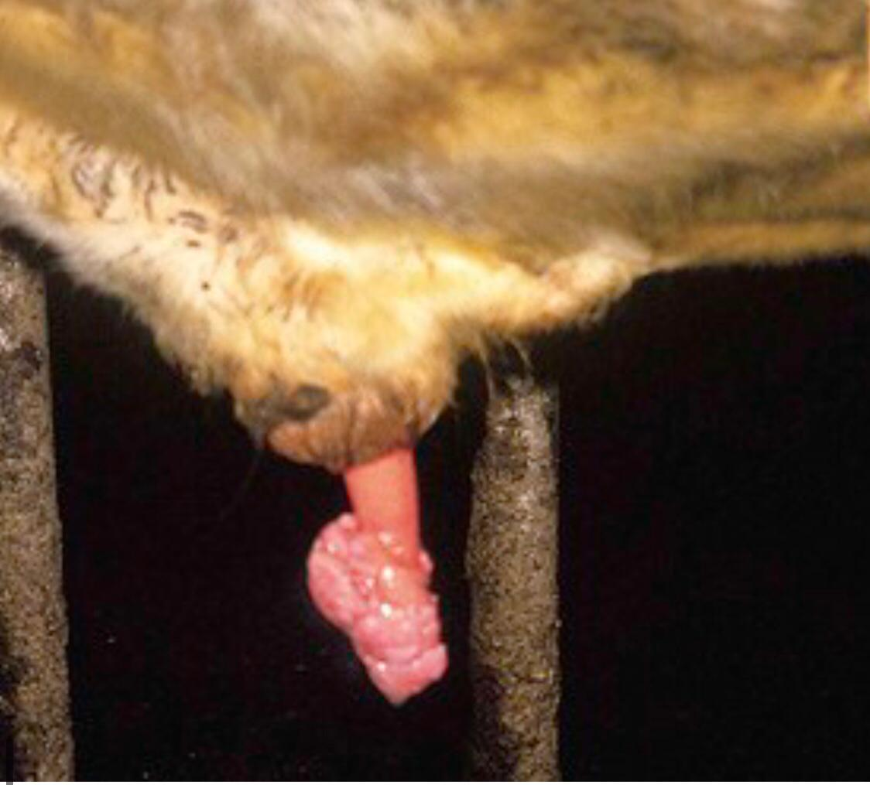

Slide 67
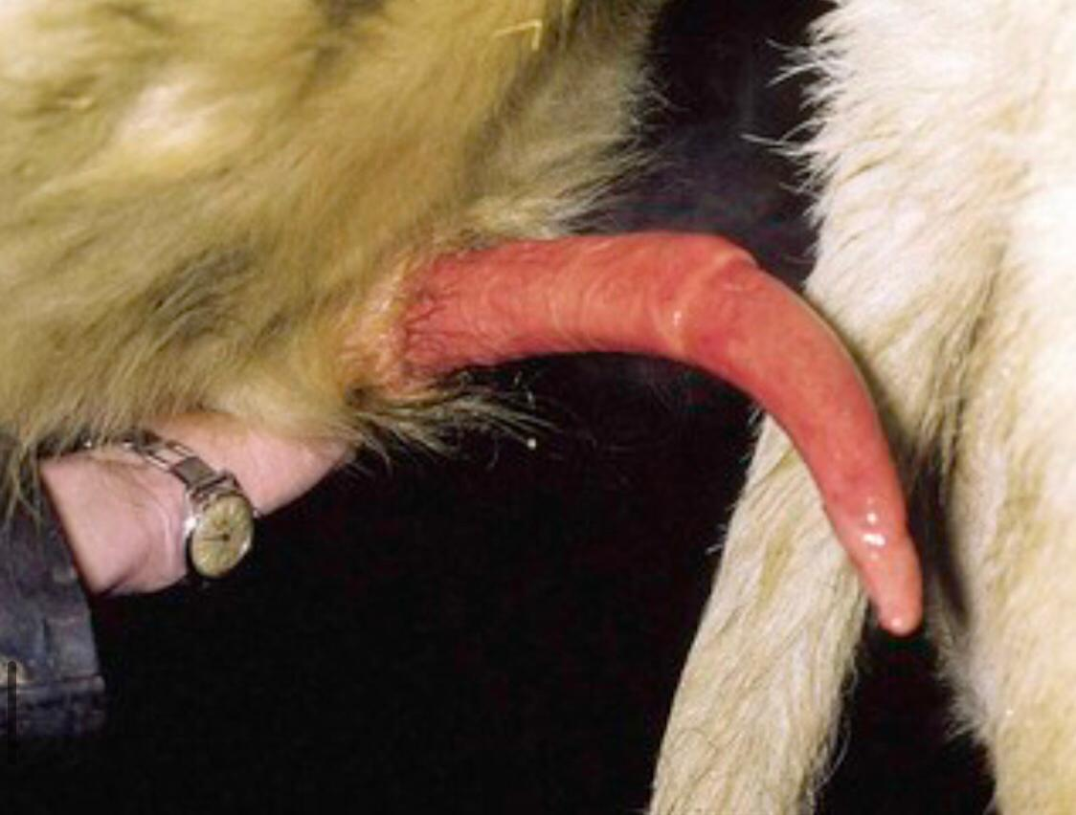
Spiral deviation of penis (“corkscrew penis”) in bull

Slide 68
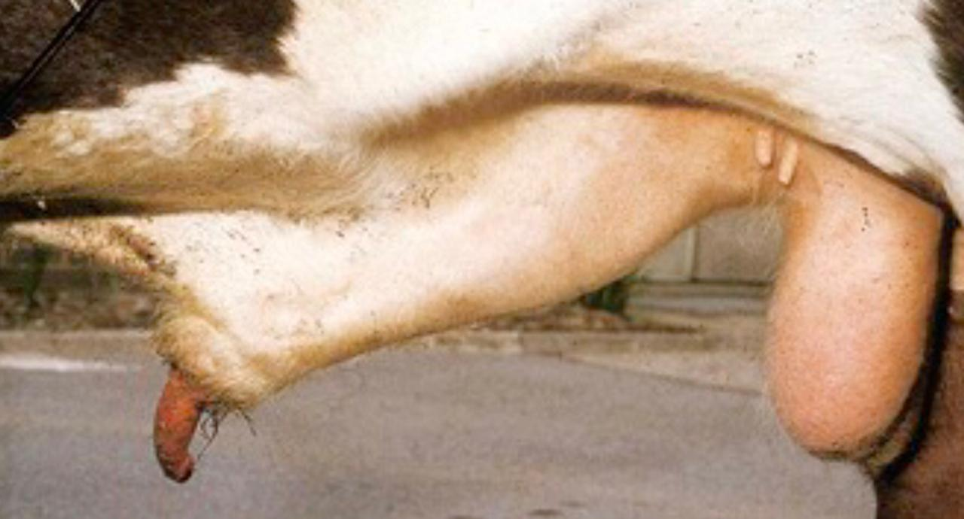
Penile hematoma (“broken penis”) with secondary penile prolapse in bull

Slide 69
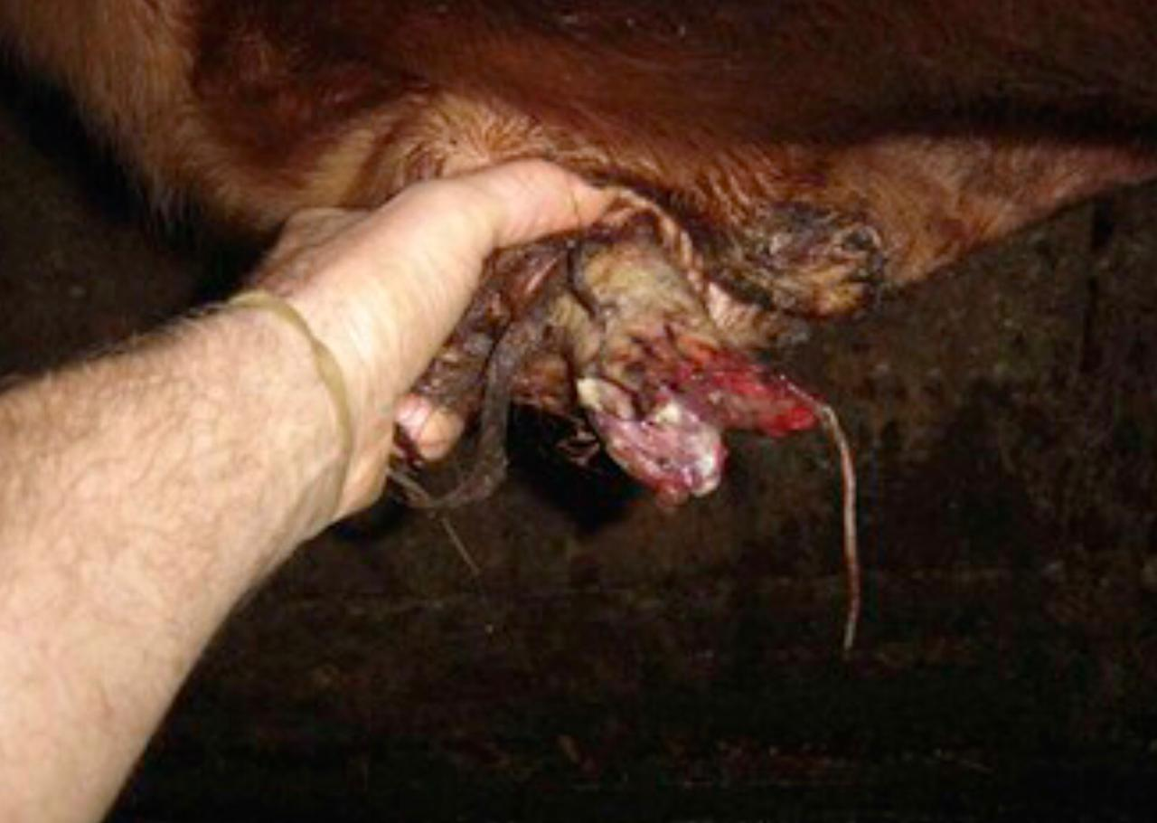
Penile trauma

Slide 70
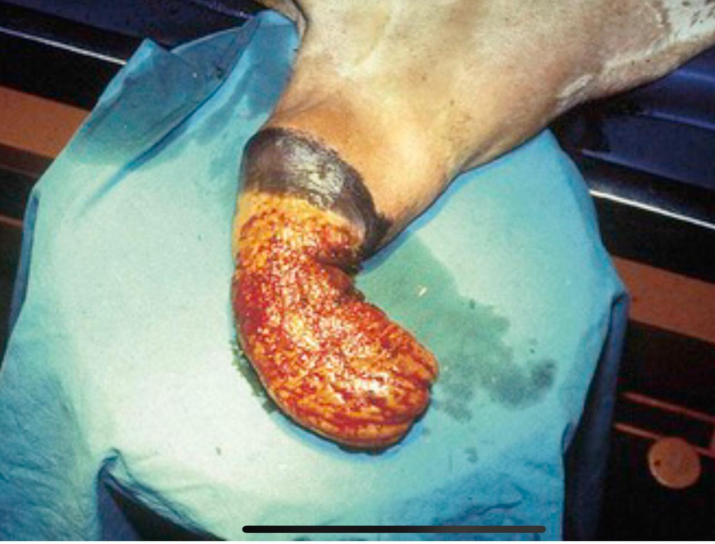
Prolapsed prepuce (preputial eversion) mucosa lining the preputial cavity prolapses through the preputial orifice.
Preputial prolapse in bull

Slide 71
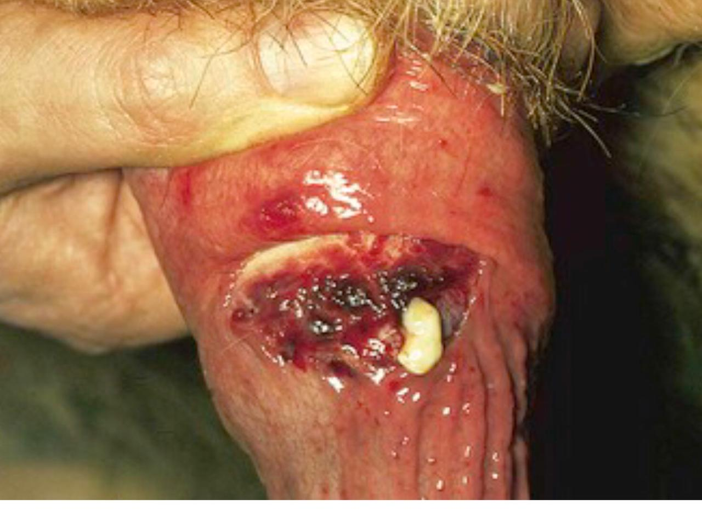
6-Preputial and penile abscess
Penile abscess in bull

Slide 72


